Slide 1
CUSTOMER RETENTION CASE STUDY

Slide 2
Introduction
Problem Statement:
Customer satisfaction has emerged as one of the most important factors that guarantee the success of online store; it has been posited as a key stimulant of purchase, repurchase intentions and customer loyalty. A comprehensive review of the literature, theories and models have been carried out to propose the models for customer activation and customer retention.
Five major factors that contributed to the success of an e-commerce store have been identified as: service quality, system quality, information quality, trust and net benefit.
The research furthermore investigated the factors that influence the online customers repeat purchase intention. The combination of both utilitarian value and hedonistic values are needed to affect the repeat purchase intention (loyalty) positively.
The data is collected from the Indian online shoppers. Results indicate the e-retail success factors, which are very much critical for customer satisfaction.
The data is collected from
E-retail factors for customer activation and retention: A case study from Indian e-commerce customers

Slide 3
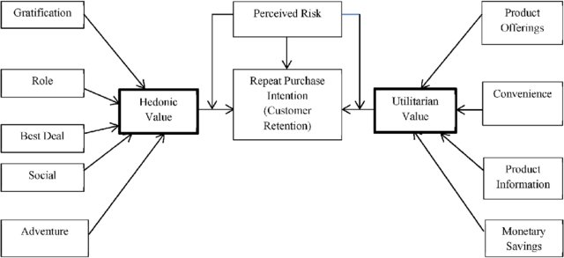

Slide 4
Table of Contents:
Exploratory Data Analysis
Checking type of data
Checking columns of the data
Checking shape of the data
Check there are null values present in the data
if present handle it,
if it is a numerical column then fill it with mean() of that column
If it is a categeorical column fill it with mode() of that column

Slide 5
Check the correlation of the data
Check the description of the data,which tells statistical information about the data like,count, min,max,standard deviation, and the quartiles data
Check the outliers present in the data, which tells some of the datapoints are outside the whiskers so, we have to handle it
Check the skewness of the data
Data visualization:
Here we have visualized the data by univariate,By variate/multivariate analysis
Countplot
Scatter plot
pair plot

Slide 6
Data Sources and their formats
We got the data in the form of excel sheet
And read that excel file into jupyter notebook i.e loading our data
Import the necessary libraries
import pandas as pd
import numpy as np
import matplotlib.pyplot as plt
import seaborn as sns
import warnings
warnings.filterwarnings('ignore')
And load the excel file
df=pd.read_excel(r'C:\Users\polasasuresh\Downloads\Customer_retention_dataset-\customer.xls')
df

Slide 7
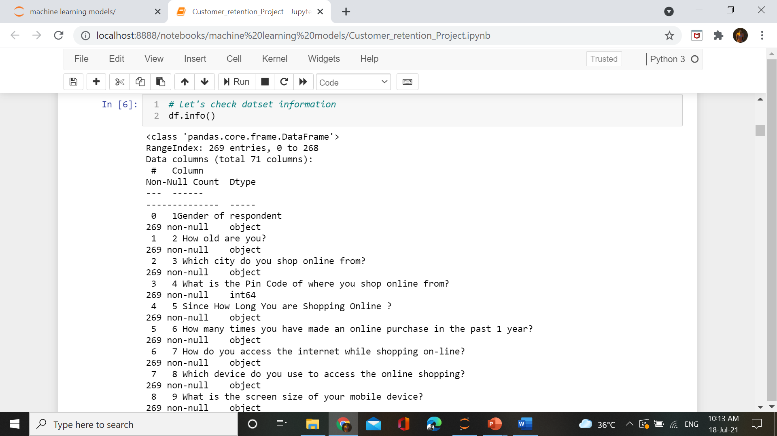
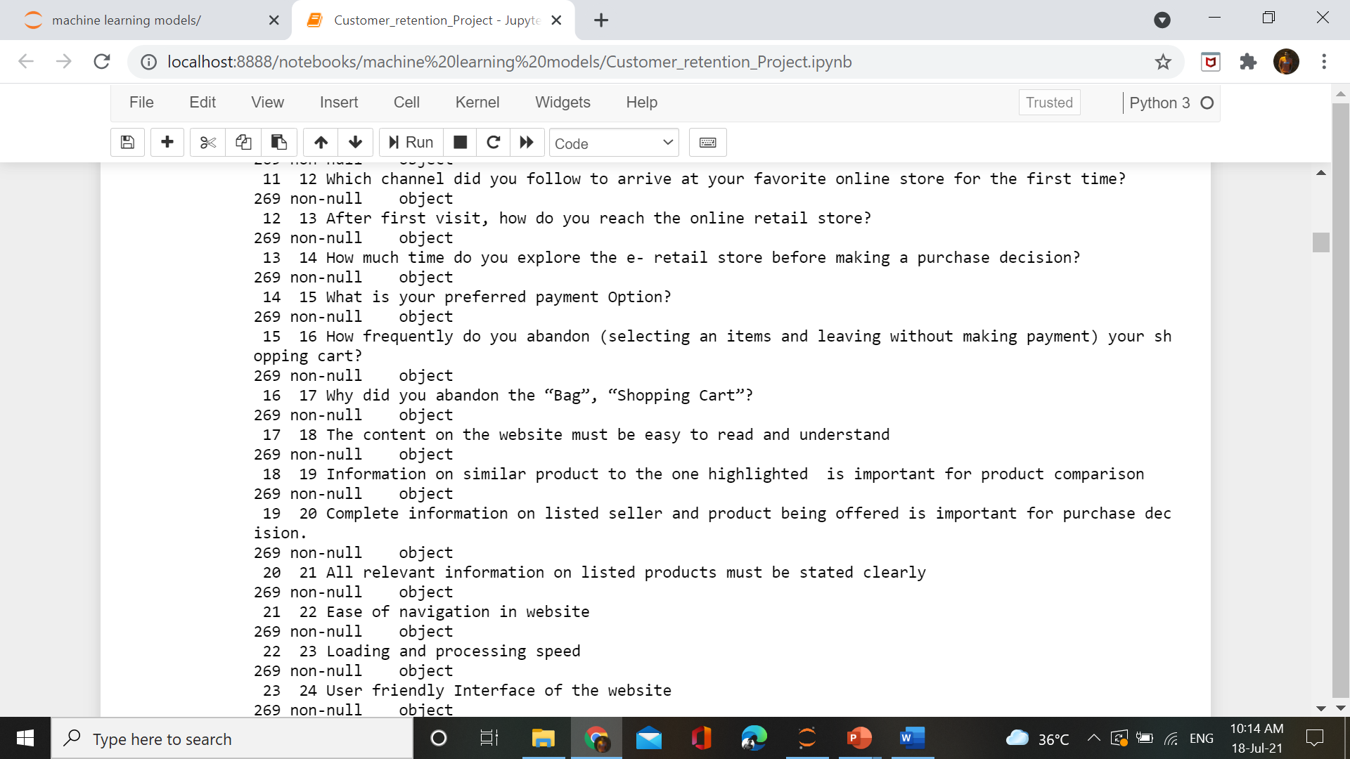
#check the columns present in the dataset
df.columns
Gives the total number of columns present in the data. Here total 71 columns present

Slide 8
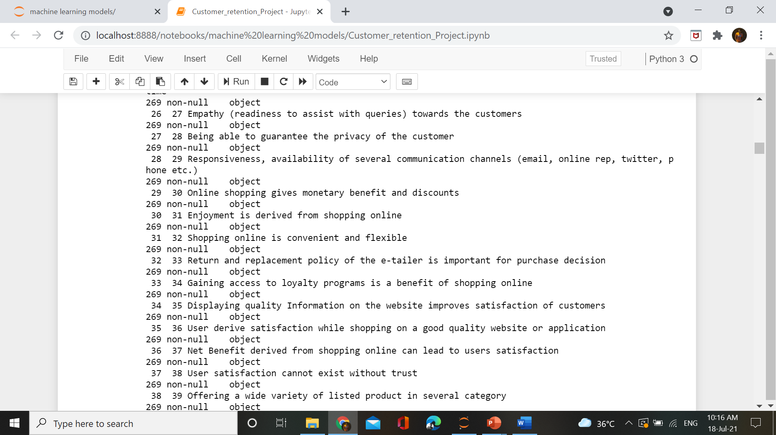
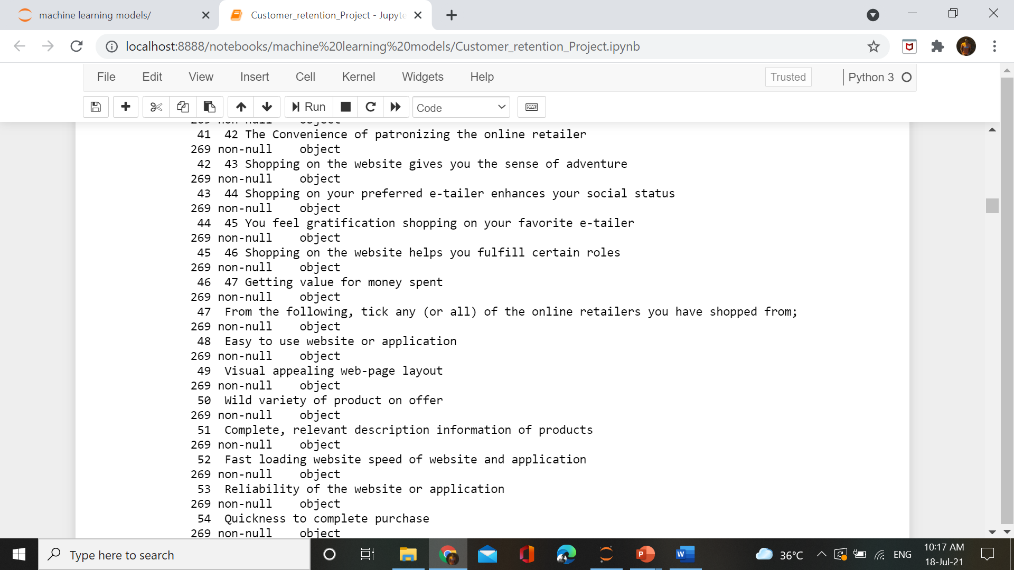

Slide 9
Data Preprocessing
To clean the data ,here we have to check the null values
df.isnull().sum()
1Gender of respondent 0
2 How old are you? 0
3 Which city do you shop online from? 0
4 What is the Pin Code of where you shop online from? 0
5 Since How Long You are Shopping Online ? 0
..
Longer delivery period 0 Change in website/Application design 0
Frequent disruption whenmoving from one page to another 0
Website is as efficient as beforeWhich of the Indian online retailer would you recommend to friend? 0
Length: 71, dtype: int64
There is no null values present in the data

Slide 10
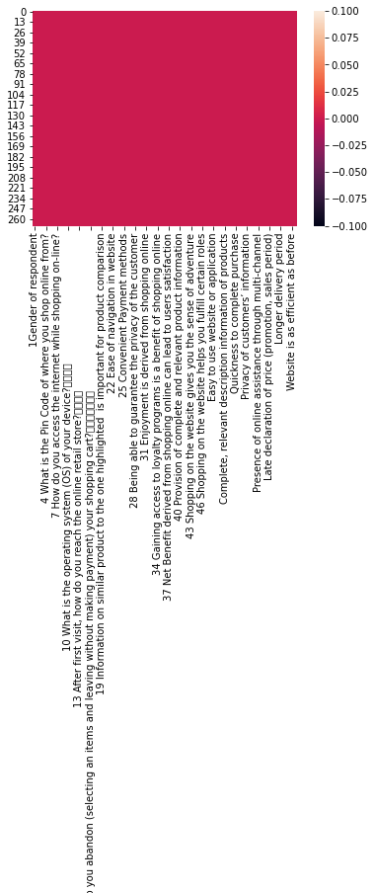
We can check with heat map
sns.heatmap(df.isnull())
plt.figure(figsize=(14,7))
plt.show()

Slide 11
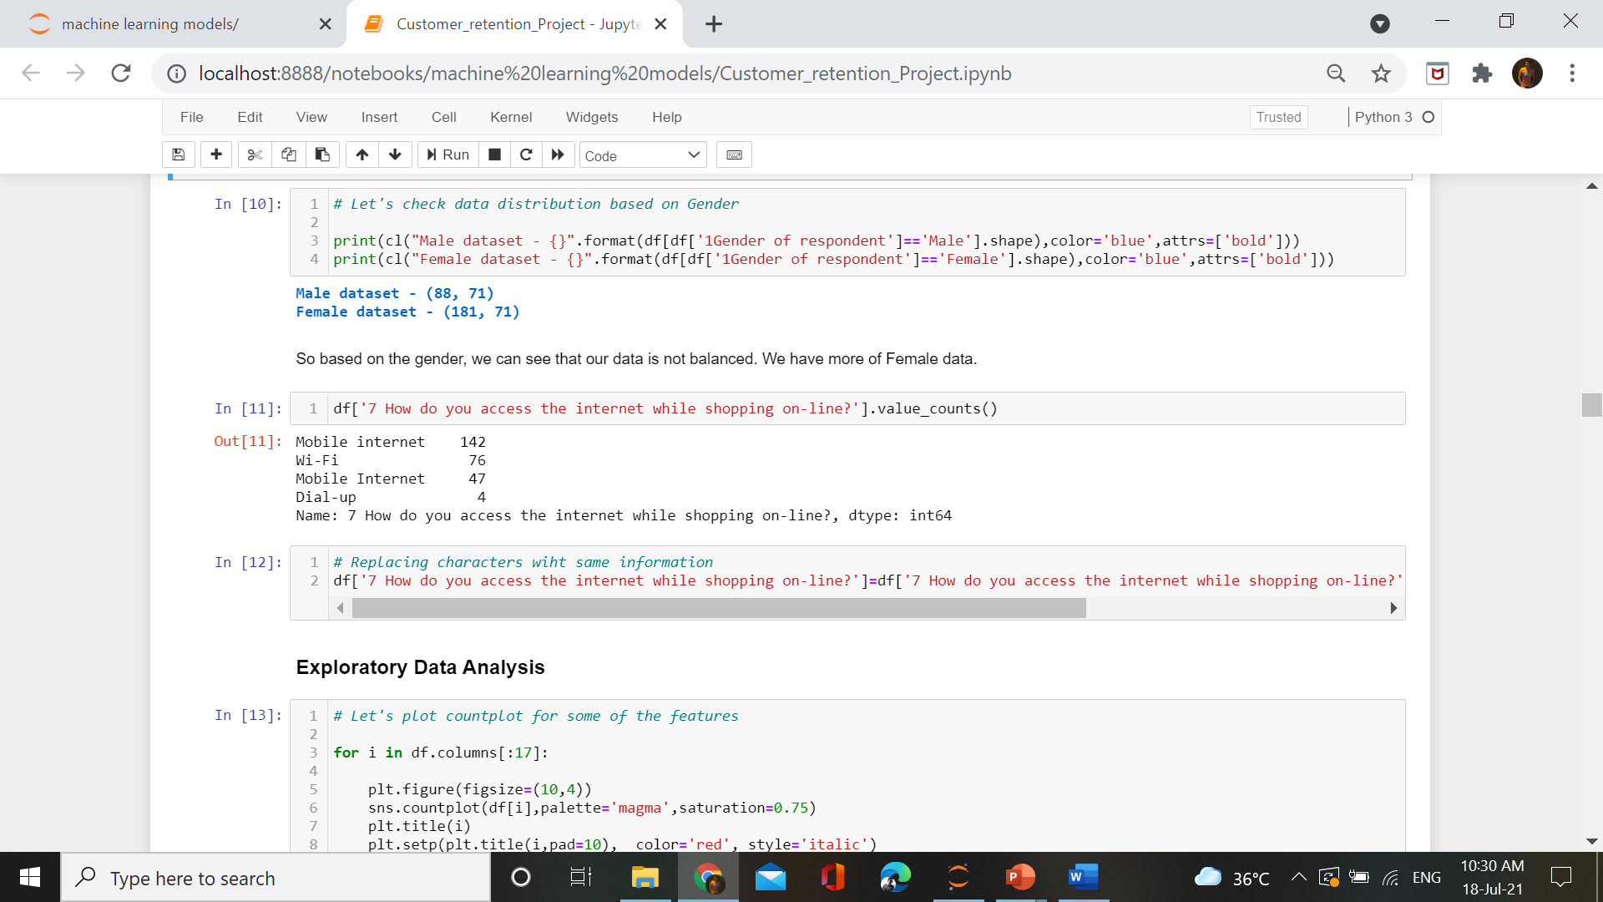
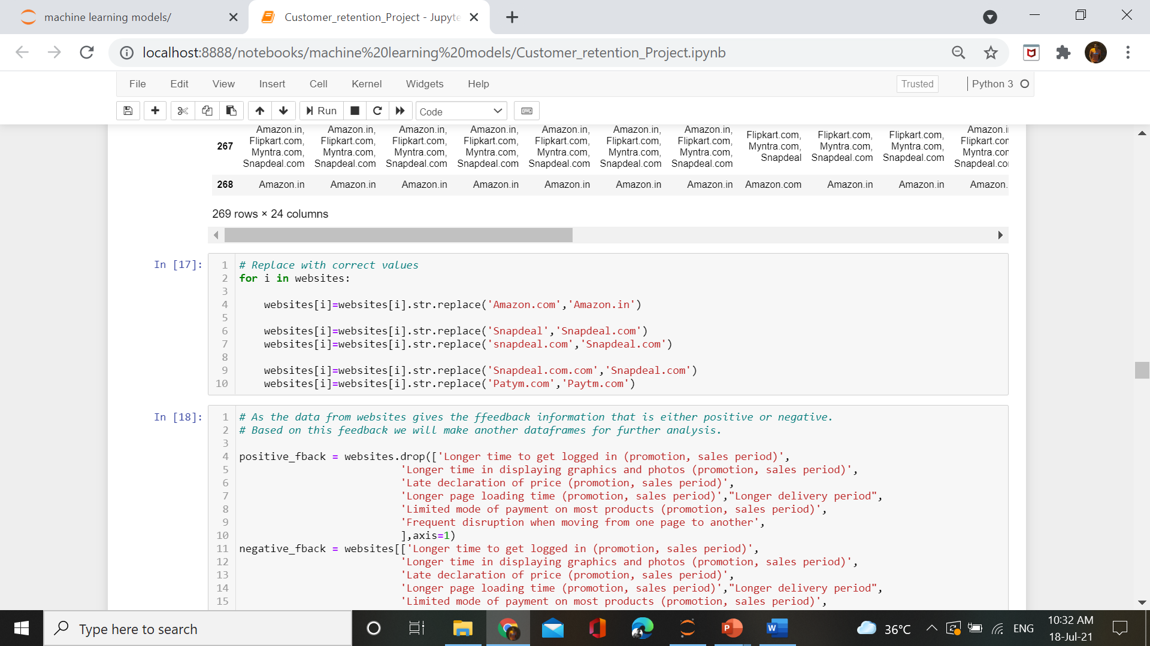
Replacing with proper formats

Slide 12
Hardware and Software Tools used
There is no hardware used
Software:Jupyter Notebook (Anaconda) , Microsoft windows,Microsoft Power point
Languages used: pandas
Libraries:
Pandas
Numpy
Matplotlib
Seaborn

Slide 13
Exploratory Data Analysis

Slide 14
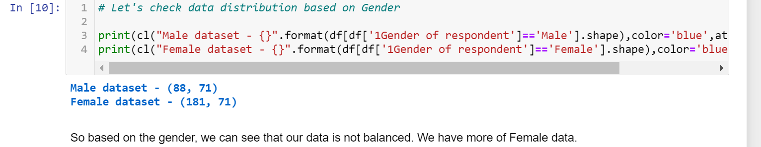
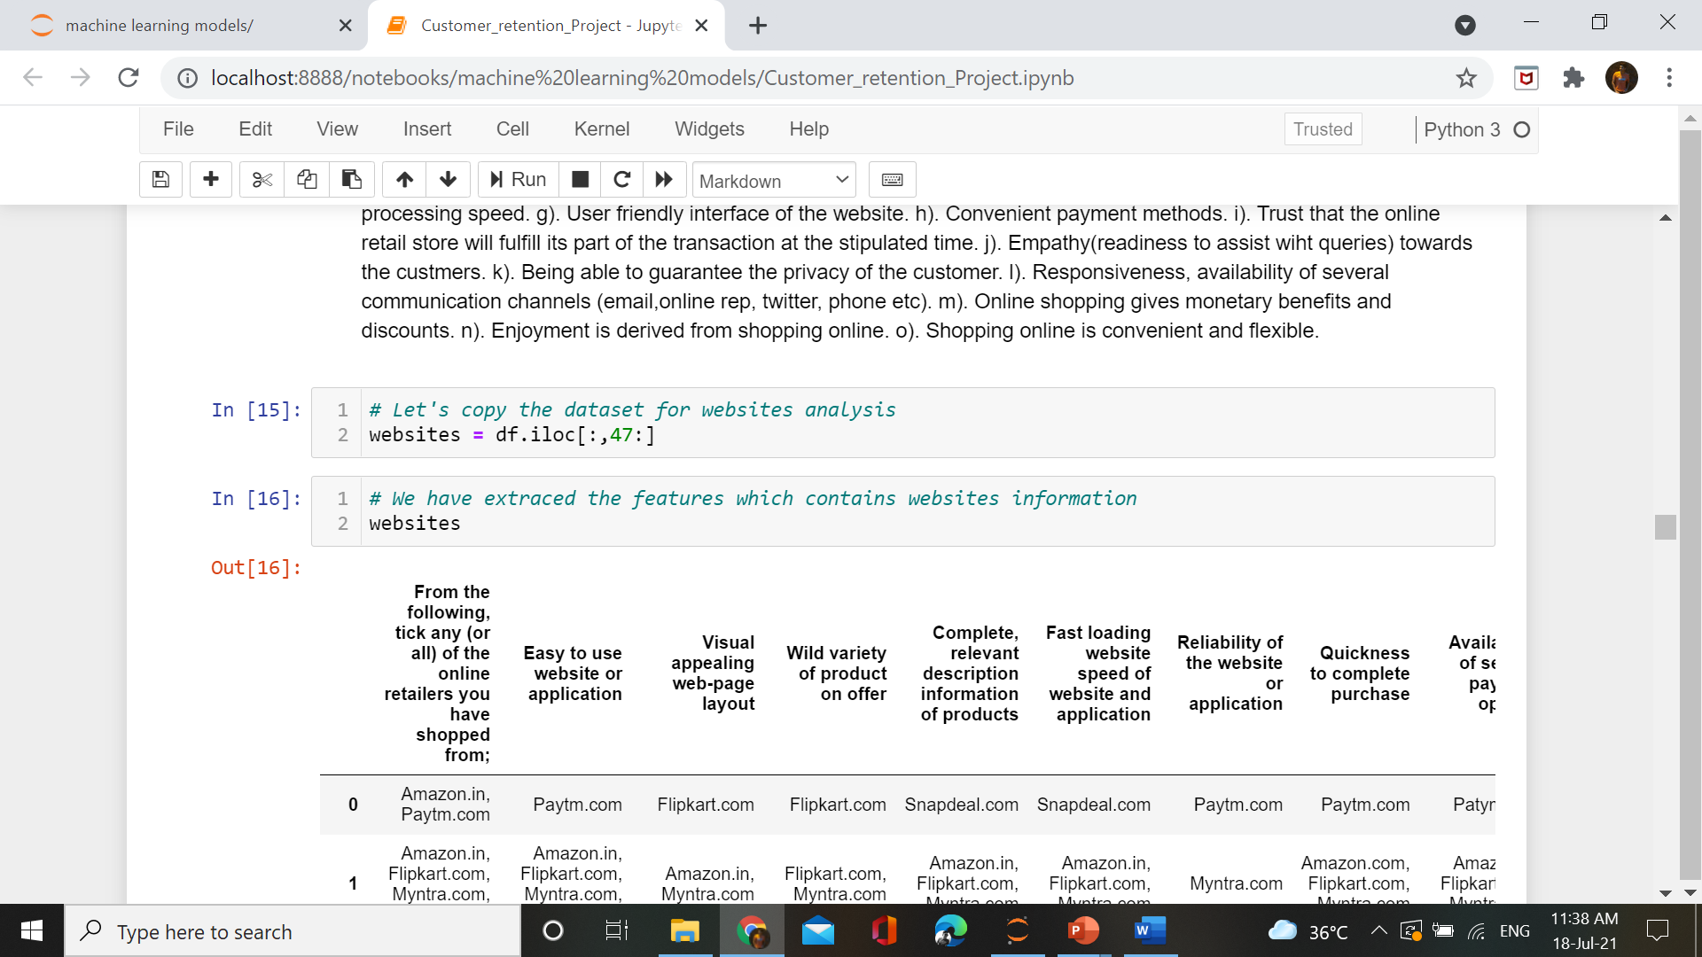
Checking gender wise data

Slide 15
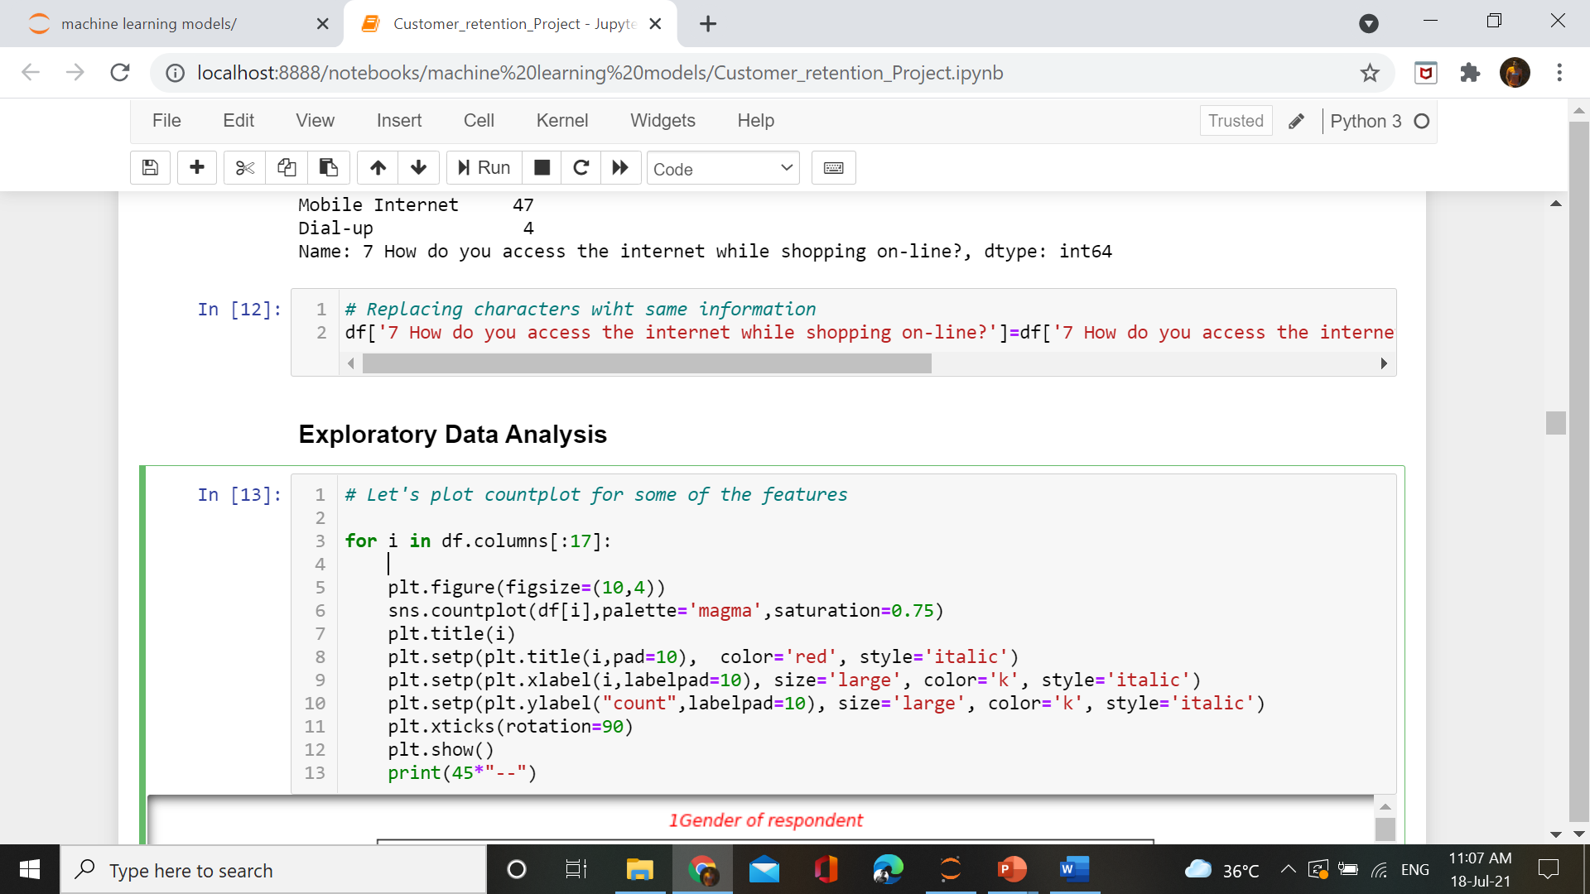
Visualization
Created a function for plotting the data

Slide 16
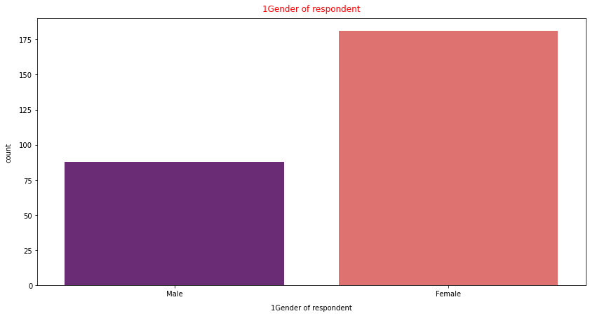
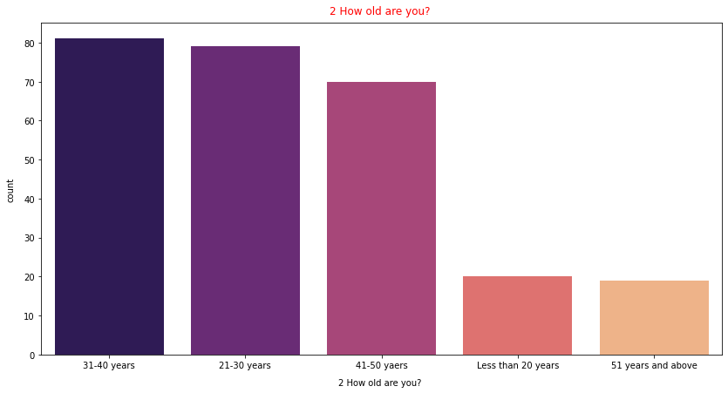

Slide 17
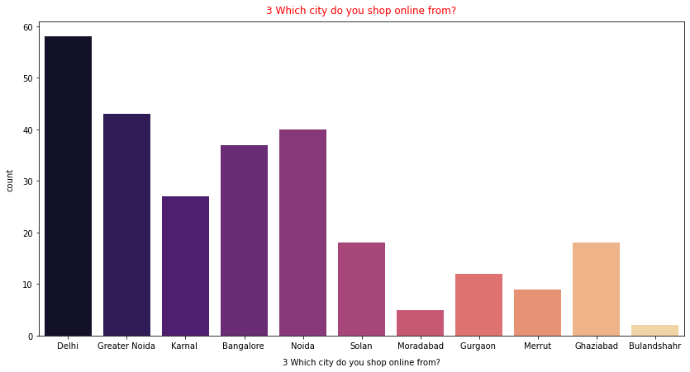
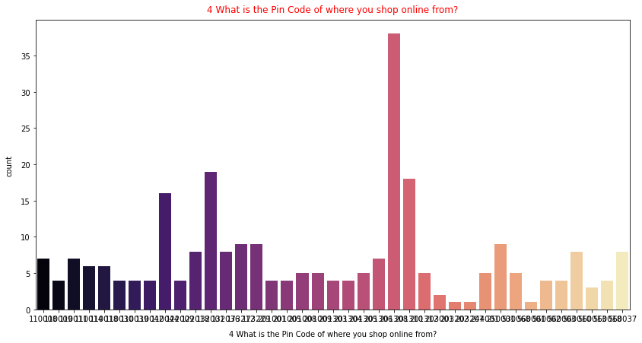

Slide 18
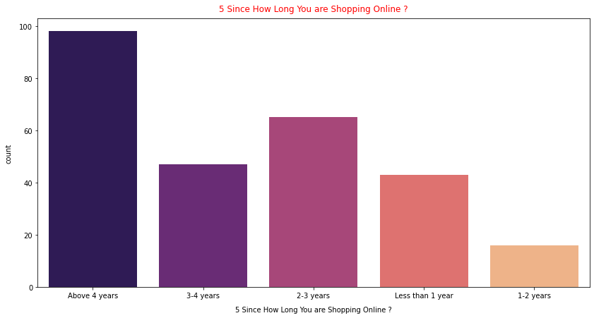
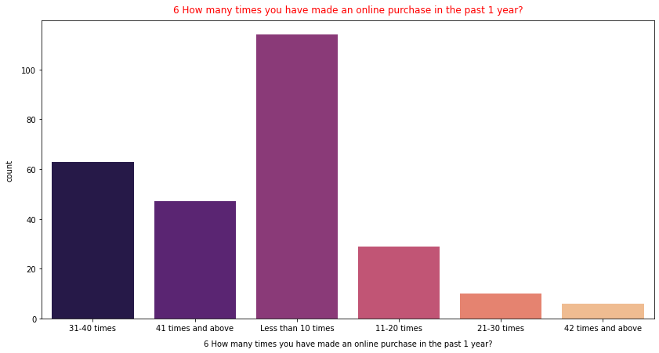

Slide 19
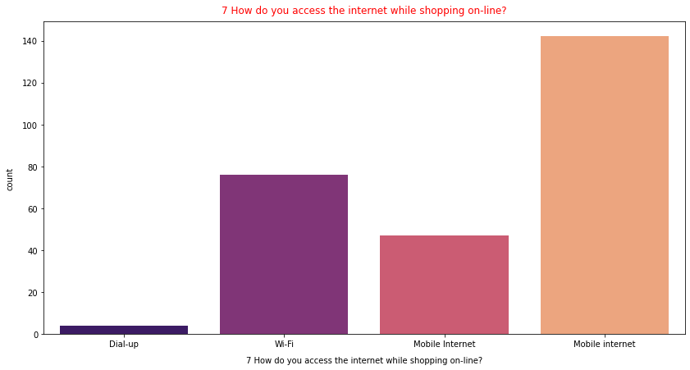
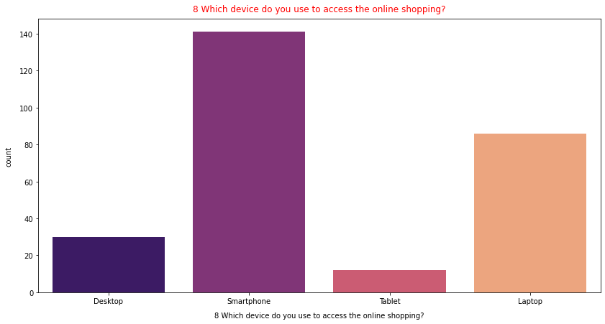

Slide 20
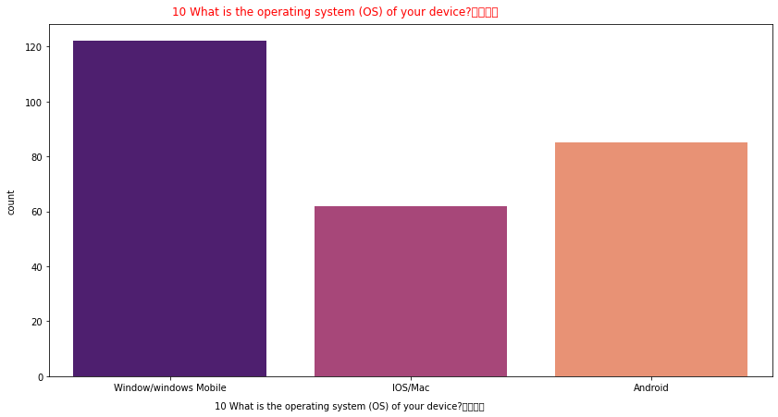
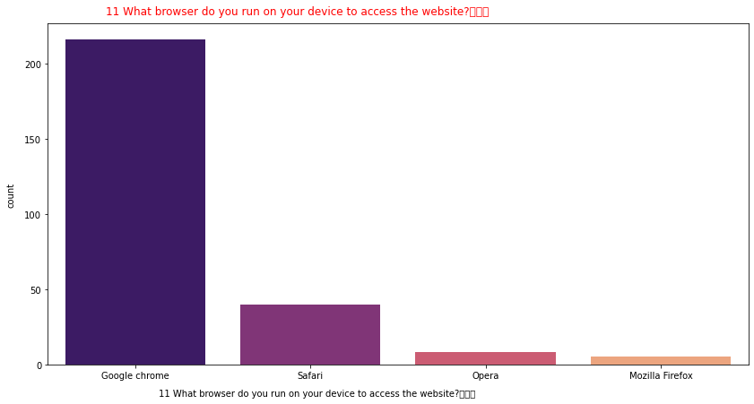

Slide 21
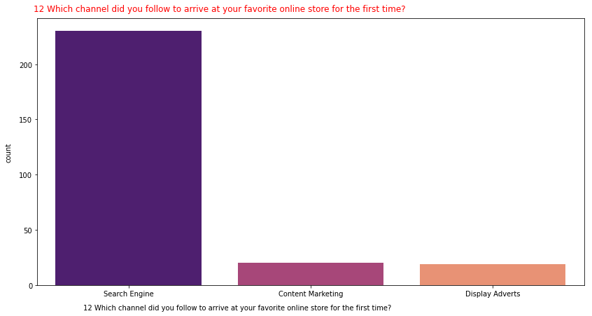
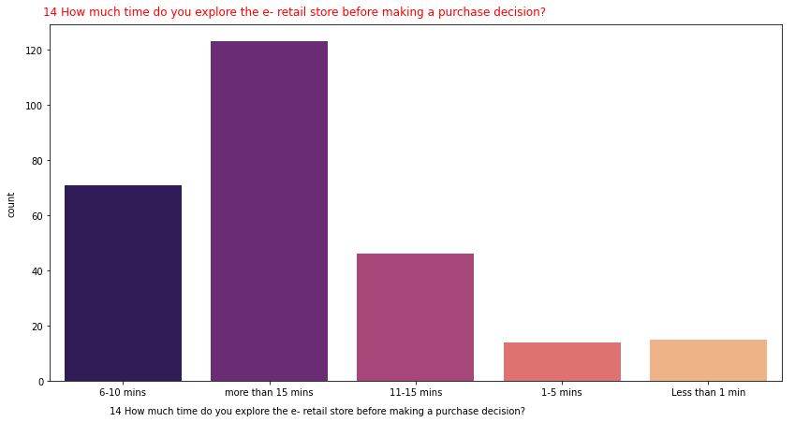

Slide 22
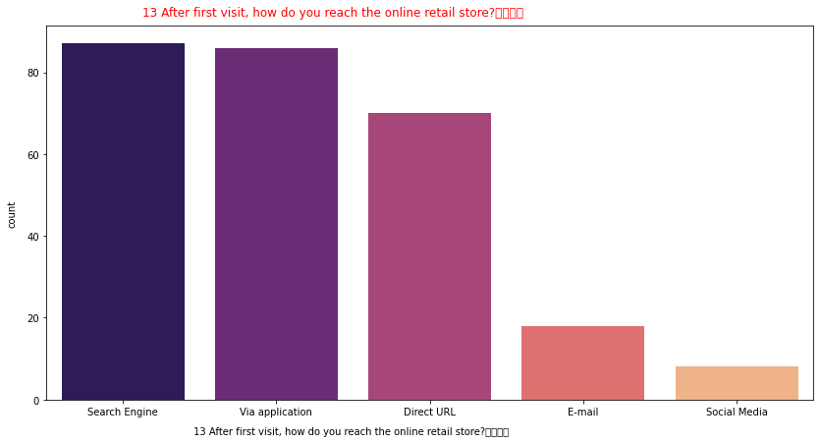
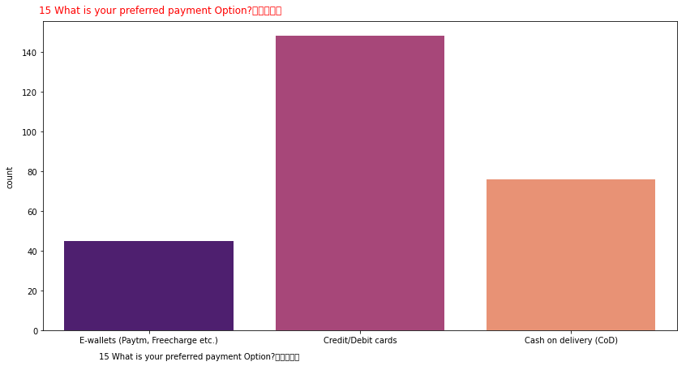

Slide 23
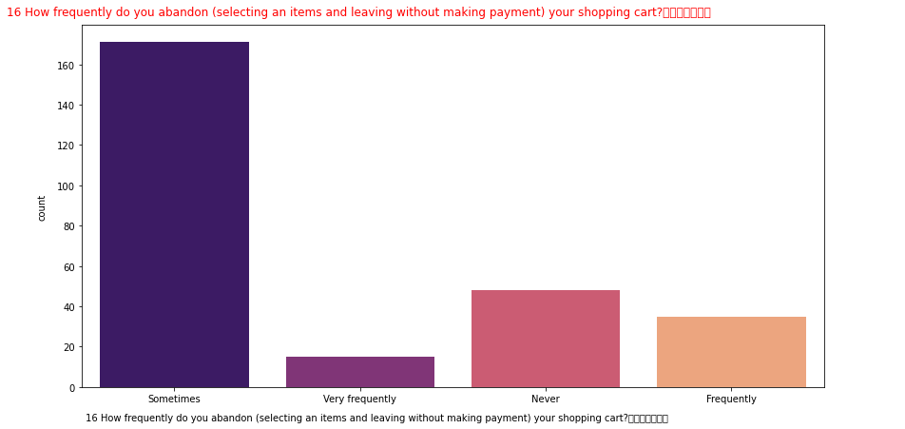

Slide 24
1
observations from countplot:
.females are doing more shopping through online shopping than male.
.In cities like "Delhi, Greater NOida & Bangolore" are doing more
shopping throgh onlines may be beacause of their busy schedule or
easy/quick delivery
based on time period There are many customers doing online shopping
since more than 4 yrs while every year new customer is added.
No.of times online purchase done in last 1 yr is more no of customer
done online shopping upto 10 times
Most of the customers are using "Mobile Internet" for online shopping.
Most of the customers doing online shopping through their mobile Phones

Slide 25
and laptops only.
The screen size they are using is "others & 5.5 inches". may be the
Customers are using the scrrens of more than 5.5 screen i.e laptops
Most of the customers are using the operating system of "window/windows
mobile"than Android.
The browser they are using is "Google Chrome“
"Search Engine" channel is mostly used by the customers to do online
Shopping
The cusomers are again using the "search Engine or Application of the
store" to reach the online retail store.
most of the customers are spnding morethan 15 mins on e-retail store
before making purchase.
most of the customers are doing payments through credit/debit cards
The customers are abandon the items sometimes because they are getting
better roducts in less price and good quality

Slide 26

CHECKING CORRELATION
df.corr()
corr_mat=df.corr()
plt.figure(figsize=[80,80])
sns.heatmap(corr_mat,annot=True)
plt.title("CorrelationMatrix")
plt.savefig('correlation_matrix.jpg')
plt.show()

Slide 27
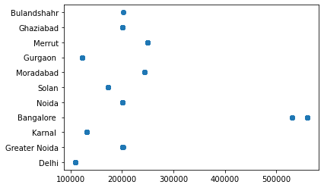
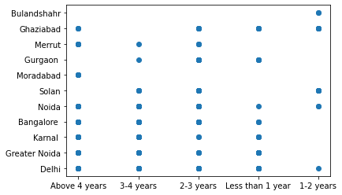
Bivariate Analysis
plt.scatter(df['4 What is the Pin Code of where you shop online from?'],df['3 Which city do you shop online from?'])
plt.scatter(df['5 Since How Long You are Shopping Online ?'],df['3 Which city do you shop online from?'])

Slide 28
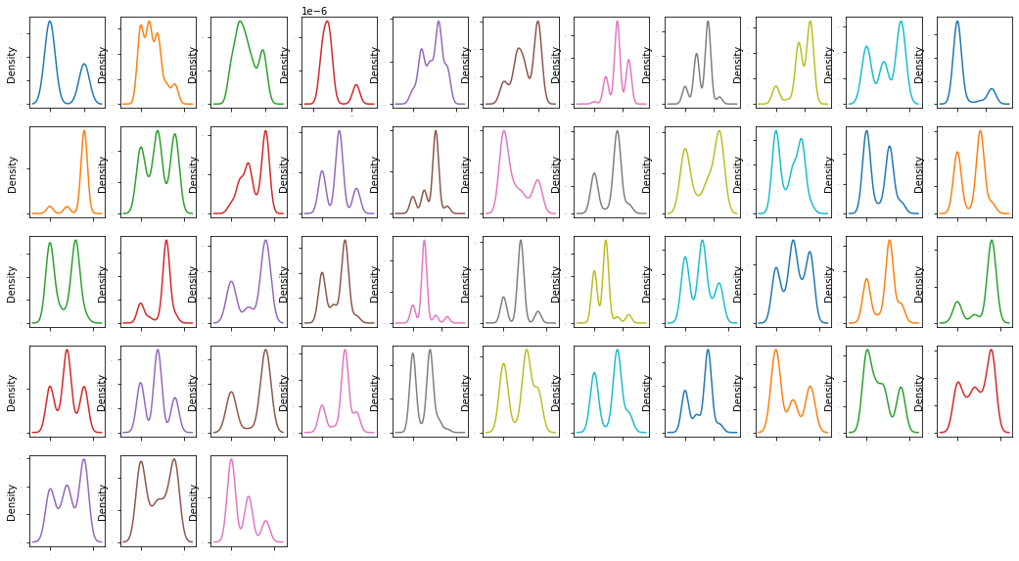
changing the categeorical values into numerical by using OrdinalEncoder
from sklearn.preprocessing import OrdinalEncoder enc=OrdinalEncoder()
for i in df.columns[:47]:
if df[i].dtypes=='object':
df[i]=enc.fit_transform(df[i].values.reshape(-1,1))
df
Let's check the data distribution among all the columns

Slide 29
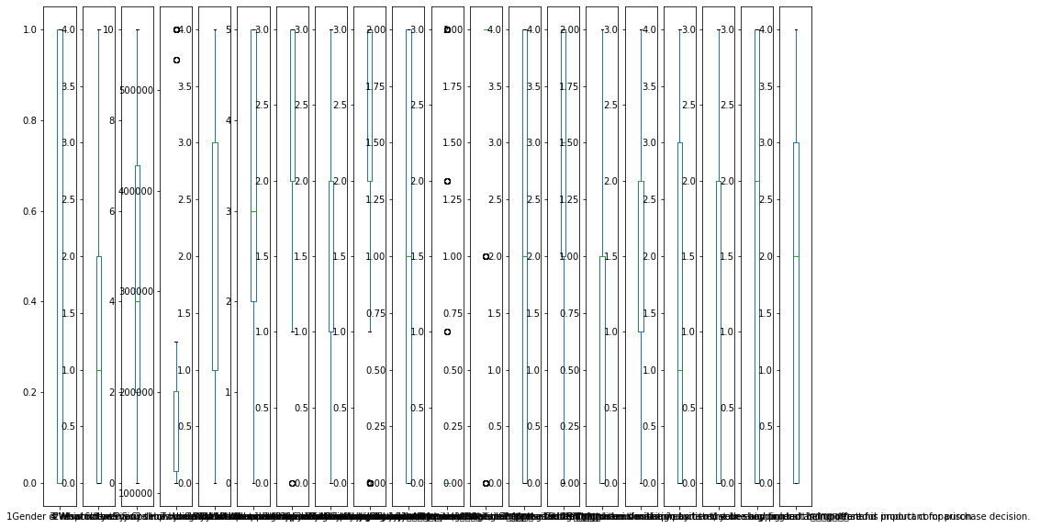
checking outliers
There are 71 columns in dataset so its not possible to plot each and every columns seperately or plot all together also,so we will print some of the columns first and later ones as second
#plotting boxplots for first 20 columns
df1=df.iloc[:,:20]
df1.plot(kind='box',subplots=True,figsize=(15,10))
plt.show()

Slide 30
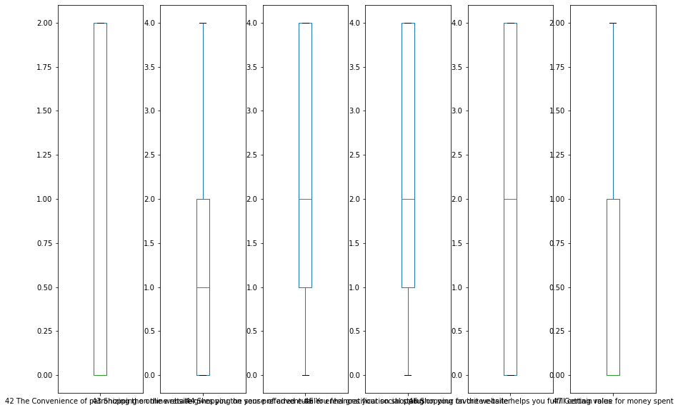
df1=df.iloc[:,21:40]
df1.plot(kind='box',subplots=True,figsize=(15,10)) plt.show()
df1=df.iloc[:,41:72]
df1.plot(kind='box',subplots=True,figsize=(15,10))
plt.show()

Slide 31
There are no outliers present in the data.
Analysing the websites data
websites=df.iloc[:,47:]
websites
df['From the following, tick any (or all) of the online retailers you have shopped from; '].value_counts()
]: Amazon.in, Flipkart.com, Paytm.com, Myntra.com, Snapdeal.com 82
Amazon.in, Flipkart.com, Myntra.com, Snapdeal.com 44
Amazon.in, Flipkart.com 32
Amazon.in, Flipkart.com, Paytm.com, Snapdeal.com 29
Amazon.in, Flipkart.com, Snapdeal.com 27
Amazon.in, Paytm.com, Myntra.com 20
Amazon.in 16
Amazon.in, Paytm.com 12
Amazon.in, Flipkart.com, Paytm.com 7
Name: From the following, tick any (or all) of the online retailers you have sh opped from;
, dtype: int64

Slide 32
for i in websites:
websites[i]=websites[i].str.replace('Amazon.in','Amazon.com') websites[i]=websites[i].str.replace('Snapdeal','Snapdeal.com')
websites[i]=websites[i].str.replace('Snapdeal.com.com','Snapdeal.com') websites[i]=websites[i].str.replace('Paytm.com','Paytm.com')
websites[i]=websites[i].str.replace('Flipkart.com','Flipkart.com') websites
plt.figure(figsize=(14,7))
sns.countplot(df['From the following, tick any (or all) of the online retailers you have shopped from; '],hue=df['1Gender of respondent'])
plt.xticks(rotation=45)
array([0, 1, 2, 3, 4, 5, 6, 7, 8]), [Text(0, 0, 'Amazon.in, Paytm.com'), Text(1, 0, 'Amazon.in, Flipkart.com, Myntra.com, Snapdeal.com'), Text(2, 0, 'Amazon.in, Paytm.com, Myntra.com'), Text(3, 0, 'Amazon.in, Flipkart.com, Paytm.com, Myntra.com, Snapdeal.com'), Text(4, 0, 'Amazon.in, Flipkart.com, Paytm.com, Snapdeal.com'), Text(5, 0, 'Amazon.in, Flipkart.com'), Text(6, 0, 'Amazon.in, Flipkart.com, Snapdeal.com'), Text(7, 0, 'Amazon.in'), Text(8, 0, 'Amazon.in, Flipkart.com, Paytm.com')])

Slide 33
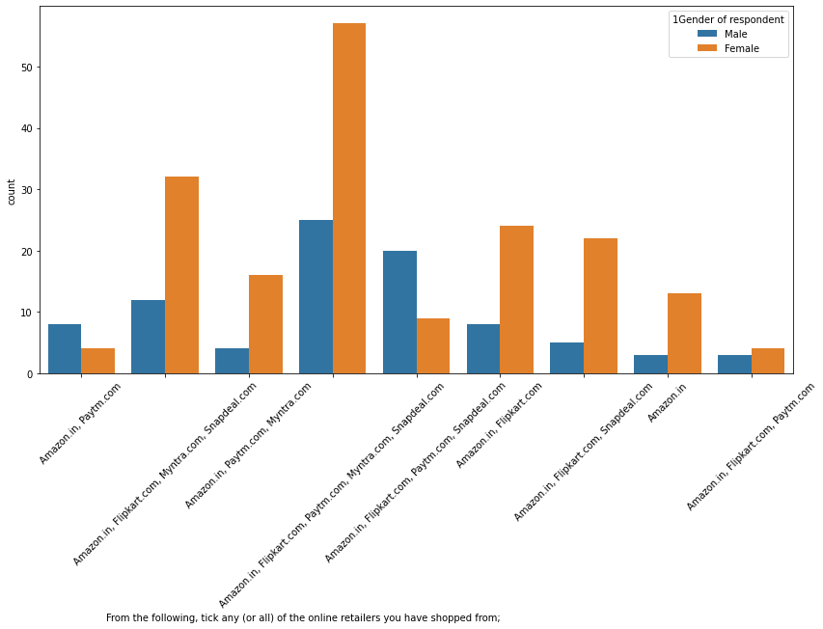

Slide 34
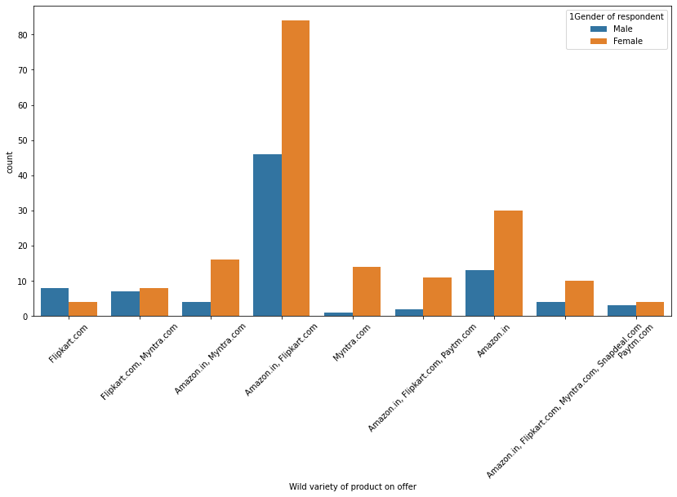
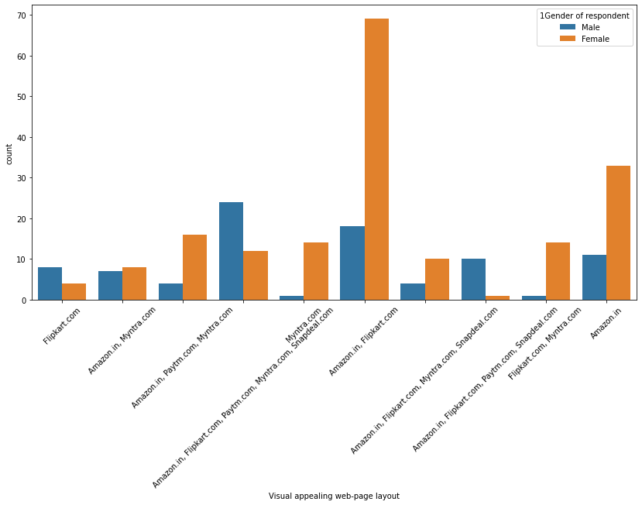

Slide 35
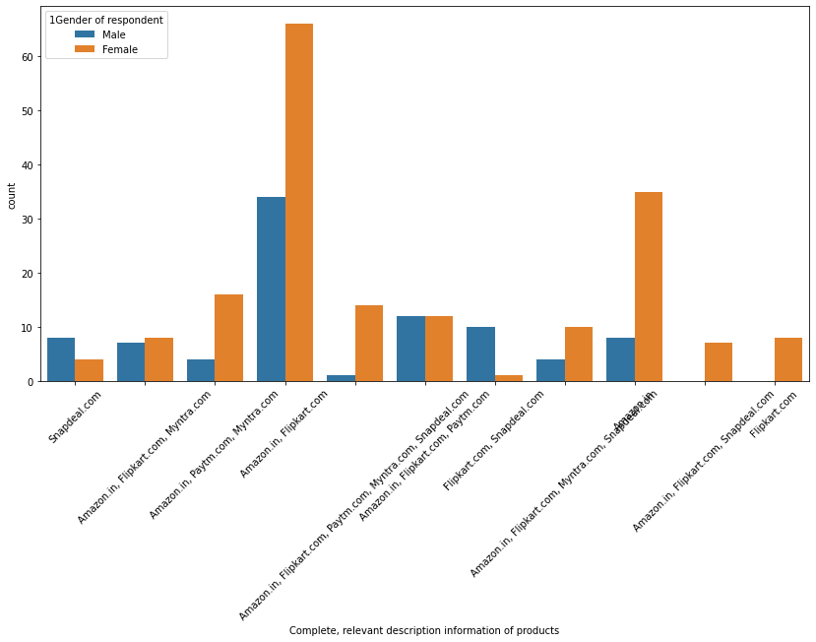

Slide 36
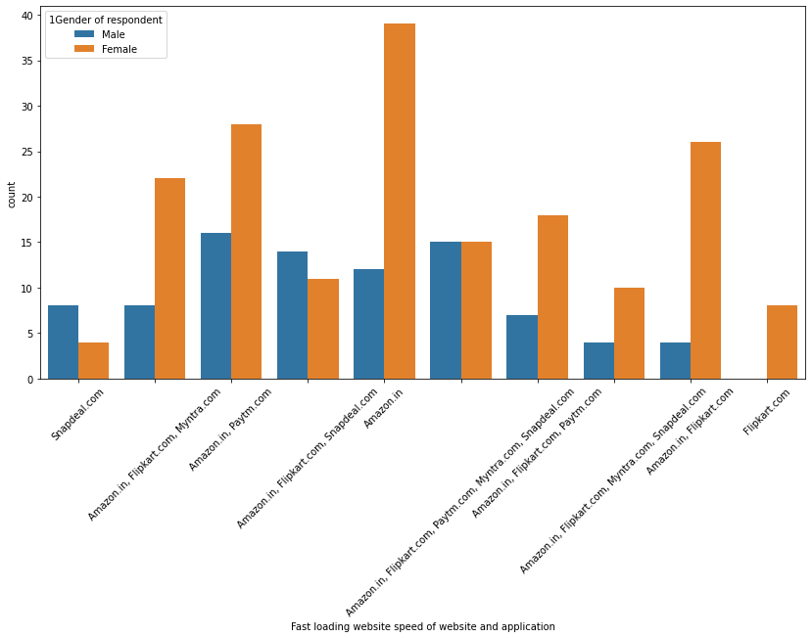
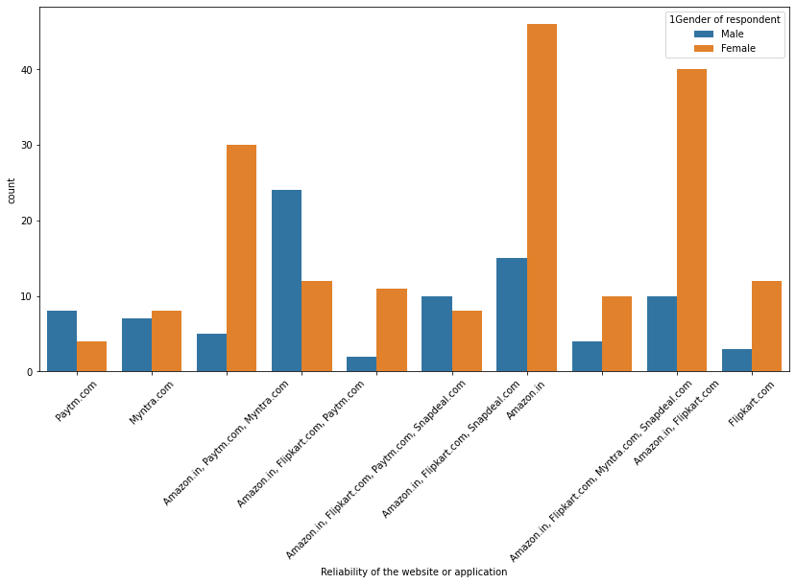

Slide 37
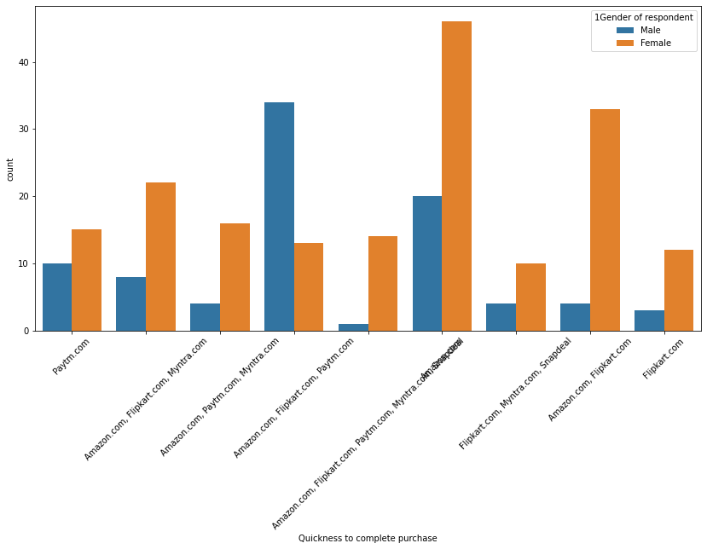
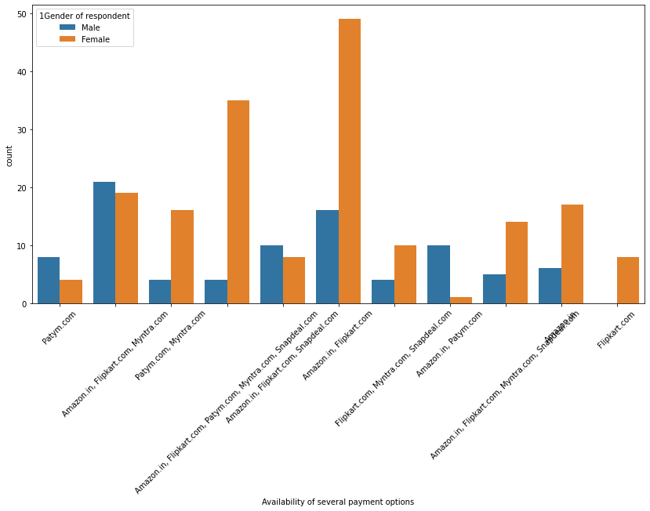

Slide 38
From the following, tick any (or all) of the online retailers you have shopped from; most of the people shopped from Amazon.in,Myntra.com and paid from paytm.com
most of the people used Amazon.in, Flipkart.com, Paytm.com, Myntra.com, Snapdeal.com(64) as Ease to use website or application
Amazon.in, Flipkart.com are mostly used as Visual appealing web-page layout
Wild variety of product on offer is on Amazon.in and flipkart.com are the two sites widely used
Complete, relevant description information of products is given by Amazon.in and Flipkart.com sites only
Fast loading website speed of website and application is in Amazon.in website
Most Reliability of the website or application is Amazon.in
For Quickness to complete purchase females are using Amazon.com,males are using Amazon.com,Flipkart.com, and for puchasing they are using paytm.com
For Availability of several payment options females are using Amazon.com,Flipkart.com,snapdeal.com and males are using Amazon.com,Flipkart.com,snapdeal.com,Myntra.com
Privacy of customers’ information is more available in Amazon.in and then Flipkart.com and then Myntra.com
Security of customer financial information is in most in Amazon.in, and then Flipkart.com, Paytm.com, Myntra.com, Snapdeal.com
Longer time to get logged in (promotion, sales period) is in Amazon.in,Flipkart.com
Longer page loading time (promotion, sales period)' is much time in myntra.com and then snapdeal.com
Limited mode of payment on most products (promotion, sales period) is in snapdeal.com
Longer delivery period is in snapdeal.com
Frequent disruption when moving from one page to another is in Amazon.com and Myntra.com less in flipkart.com and snapdeal.com
Website is as efficient as before is Amazon.com
Which of the Indian online retailer would you recommend to a friend? is Amazon.in and Flipkart.com

Slide 39
Conclusion
Amazon.com --is the most recomanded website –page layout, easy to use, relevant descriptive information, product offers reliability of website, fastness to purchase,trust worthiness
→And it takes longer time to login, late declaration or price during sales and promotion, frequent disruption when moving from one page to another, limited mode of payment on most of products
Flipkart.com-- is the second most website recommended easy to use,payments easy, fast opening of website,trust worthy. But it display longer time for graphics, security of customer info less, less relaibility.
Myntra.com—is the Third most website recommended because of its easy access, payment options.
Paytm.com– speedy deliver of products, quickness in purchase
Snapdeal.com--- is the least website recommended because of its less payment options, no speedy delivery, longer time to go from one page to another

Slide 40
Thank you

